Slide 1
Computational Thinking
Part 2

Slide 2
Remember the path
Abstraction
Decomposition
Pattern Recognition
Algorithms

Slide 3
What is Computational Thinking?
Computational thinking is:
Organising data/information logically (Abstraction)
Breaking problems into parts (Decomposition)
Interpreting patterns and models (Pattern Recognition)
Designing and implementing algorithms (Algorithms)

Slide 4



Were you able to finish pre-class work for Computational Thinking?
Notes:
🍐 This is a Pear Deck Multiple Choice Slide. Your current options are: A: 👍, B: 👎,
🍐 To edit the type of question or choices, go back to the "Ask Students a Question" in the Pear Deck sidebar.
Hard or Easy
Use this template to do a quick temperature check and self-reflection about the homework. You can learn which students might have struggled with the assignment and therefore might need more attention today.

Slide 5

Computational Thinking in
Practice
How would you analyse and solve an issue such as below :
An application needs a piece of code that takes a number as input from the user and displays an output if it’s in between 10 … 13
Abstraction, Decomposition, Pattern Recognition, Implementation of an algorithm possible?
Notes:
🍐 This is a Pear Deck Text Slide
🍐 To edit the type of question, go back to the "Ask Students a Question" in the Pear Deck sidebar.
Opinions of students on computational thinking should be discussed with the students. They should try to predict what it might be. If they heard it before or new it before they should try to explain it to the rest of the class. Instructor should also help them discuss by sharing opinions and guiding the class.

Slide 6
Case Study : 1
Perform the actions below for the request below :
Request : An application needs a piece of code that takes a number as input from the user and displays an output if it’s in between 10 … 13
Write the pseudo code.
Sketch of the algorithm.
Write the actual code that runs considering the requirements

Slide 7
Case Study 1 : Pseudocode
Define the accepted range in start and end variables.
Take the input and store it in a variable.
Compare the input variable with the requested range.
Display the necessary information to the user whether the input value is in range or not

Slide 8
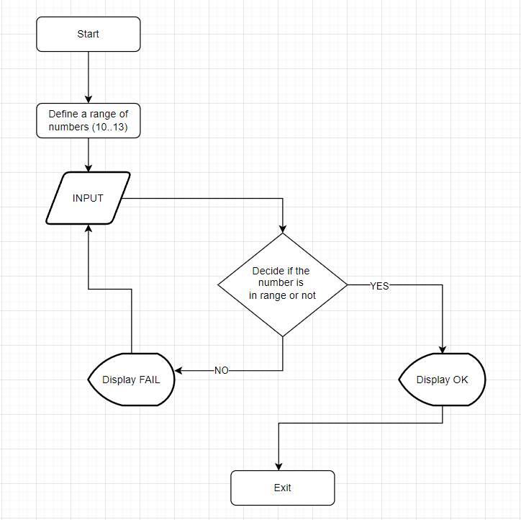
Case Study 1
Algorithm

Slide 9
Case Study 1 - The code in c#
int start = 10;
int end = 13;
Console.WriteLine("Please input a number that's in range 10..13 : ");
Int32 InputValue = Convert.ToInt32(Console.ReadLine());
if (InputValue >= start &&
InputValue <= end)
{
Console.WriteLine("OK");
}
else
{
Console.WriteLine("FAIL");
}

Slide 10
Case Study 1 - The code in Python
start = 10
end = 13
try:
user_input = int(input('Please enter a number between {} and {} : '.format(start, end)))
except ValueError:
print("Invalid entry detected ...")
exit()
if user_input in range(start, end):
print("Yes the number entered: {}".format(user_input))
else:
print("No the number entered is out of range: {}".format(user_input))

Slide 11
Case Study 1 : Summary
What we learned from Case Study 1 :
Not every request is applicable to Abstraction, Decomposition, Pattern Recognition
If statement is a general technical keyword used in Pseudocode to actual code.
How to get user inputs in a console application.
How to do branching after decisions are made.

Slide 12
Case Study : 2
Perform the actions below for the request below :
Request : Extend the capabilities of the application completed in Case Study 1 and display a warning if the input value is a negative number while keeping the code that checks the range of 10 … 13
Write the pseudo code.
Sketch of the algorithm.
Write the actual code that runs considering the requirements
What types of control logic could be added?

Slide 13
Case Study 2 : Pseudocode
Define the range of numbers.
Take the input and store it in a variable.
Compare the input variable with the predefined range.
Display the necessary information to the user whether the input value is in range or not
Display a warning message to the user if the input value is a negative number.
Exit the application.

Slide 14
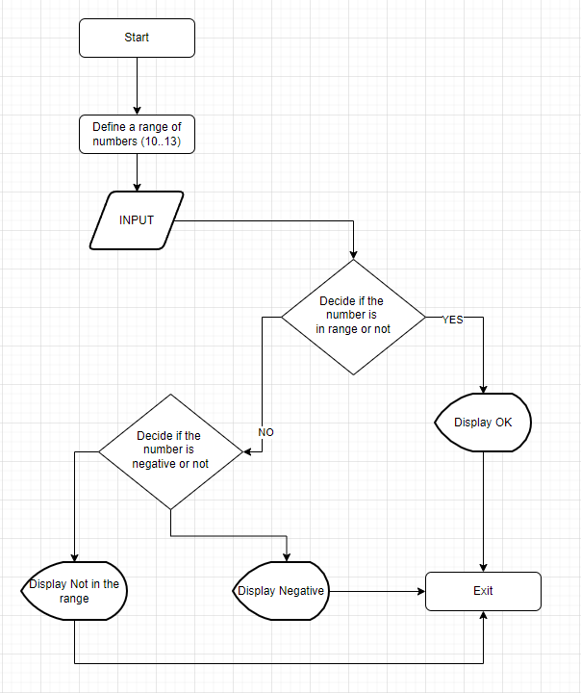
Case Study 2
Algorithm

Slide 15
Case Study 2 - The code in c#
List<int> Range = new List<int> { 10, 11, 12, 13 };
Console.WriteLine("Please input a number that's in range 10..13 : ");
var Input = Console.ReadLine();
if (Convert.ToInt32(Input) < 0)
{
Console.WriteLine("The input value is in NEGATIVE RANGE!!!");
if (Convert.ToInt32(Input) < -10)
{
Console.WriteLine("The number is negative, and even less than -10!!");
}
}
else
{
Console.WriteLine("NO the input is NOT negative!!!");
}
if (Range.Contains(Convert.ToInt32(Input)))
{
Console.WriteLine("YES the input is in defined range!!!");
}
else
{
Console.WriteLine("NO the input is not in the defined range!!!");
}
Console.ReadKey();

Slide 16
Case Study 2 - The python code
start = 10
end = 13
try:
user_input = int(input('Please enter a number between {} and {} : '.format(start, end)))
except ValueError:
print("Invalid entry detected ...")
exit()
if user_input < 0:
if user_input < -10:
print("The entered value is even less than -10")
exit()
print ("The value entered is less than 0...")
exit()
if user_input in range(start, end):
print("Yes the number entered is in range: {}".format(user_input))
else:
print("No the number entered is out of range: {}".format(user_input))

Slide 17
Case Study 2 : Summary
What we learned from Case Study 2 :
IF statements may contain inner if statements, where they can include inner if statements as well, there is no limit, but leads to spaghetti code, we must be aware of this fact.

Slide 18
Case Study : 3
Perform the actions below for the request below :
Request : Extend the capabilities of the application completed in Case Study 1 and check the input value if it fits in ranges [10..13] [18..22] [25..44]
Write the pseudo code.
Sketch of the algorithm.
Write the actual code that runs considering the requirements

Slide 19
Case Study 3 : Pseudocode
Define the range of numbers.
Take the input and store it in a variable.
Compare the input value with the predefined range1.
Compare the input value with the predefined range2.
Compare the input value with the predefined range3.
Display the corresponding messages for each ranges.
Exit the application.

Slide 20
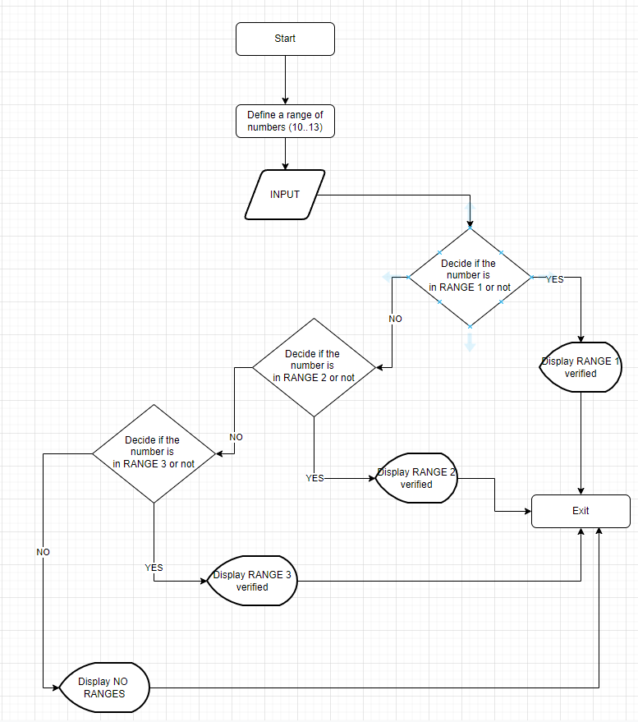
Case Study 3
Algorithm

Slide 21
Case Study 3 - The code in c#
List<int> Range1 = new List<int> { 10, 11, 12, 13, 50 };
List<int> Range2 = new List<int> { 18, 19, 20, 21, 22, 50 };
List<int> Range3 = new List<int> { 25, 26, 27, 28, 29, 30, 31, 32, 33, 34, 35, 36, 37 ,38 ,39, 40, 41, 42, 43, 44, 45, 50};
Console.WriteLine("Please input a number that's in ranges [10..13], [18..22], [25..45]");
var Input = Console.ReadLine();
if (Range1.Contains(Convert.ToInt32(Input)))
{
Console.WriteLine("YES the input is in RANGE 1!!!");
}
else if (Range2.Contains(Convert.ToInt32(Input)))
{
Console.WriteLine("YES the input is in RANGE 2!!!");
}
else if (Range3.Contains(Convert.ToInt32(Input)))
{
Console.WriteLine("YES the input is in RANGE 3!!!");
}
else
{
Console.WriteLine("NO the input is NOT in defined in any of ranges!!!");
}
Console.ReadKey();

Slide 22
Case Study 3 - The python code
user_input = int(input('Please enter a number in one of ranges:10..13 - 18..22 - 25..44 : '))
result = False
if user_input in range(10, 13):
result = True
if(user_input in range(18,22)):
result = True
if (user_input in range(25,44)):
result = True
if result:
print("The entered value is in range")
else:
print("No the entered value is not in any of ranges : {}".format(user_input))

Slide 23
Case Study 3 : Summary
What we learned from Case Study 3 :
IF statements can break down to branches by using IF ELSE statements however this would not entirely save the application from developing in direction of spaghetti code. By means of readability of the code there are better alternatives.

Slide 24
Case Study : 4
Perform the actions below for the request below :
Request : Extend the capabilities of the application completed in Case Study 3 and check the input value if it fits in ranges [10..13] [18..22] [25..44] until user presses the key X when asked.
Write the pseudo code.
Sketch of the algorithm.
Write the actual code that runs considering the requirements

Slide 25
Case Study 4 : Pseudocode
Define the range of numbers.
Take the input and store it in a variable.
Compare the input value with the predefined range1.
Compare the input value with the predefined range2.
Compare the input value with the predefined range3.
Display the corresponding messages for each ranges.
Exit the application if user presses the X key, else repeat the action from the first step.
If user presses the X key exit the application.

Slide 26
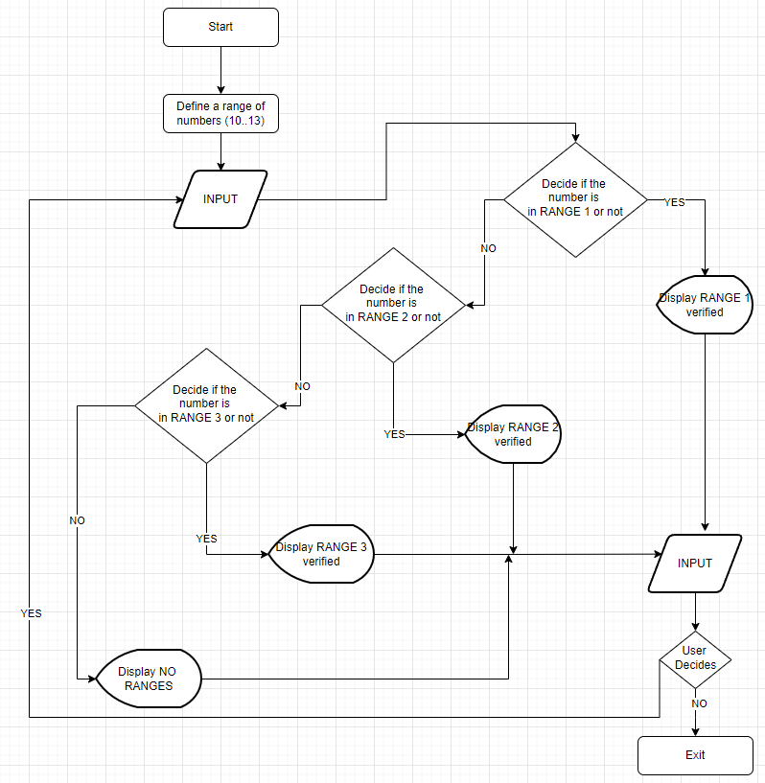
Case Study 4
Algorithm

Slide 27
Case Study 4 - The code in c#
internal class Program
{
static bool Check(int TheInput)
{
switch (TheInput)
{
case 0:
Console.WriteLine("The input is 0"); break;
case 1:
Console.WriteLine("The input is 1"); break;
case 2:
Console.WriteLine("The input is 2");
Console.WriteLine("What to do with number 2");
break;
default:
Console.WriteLine("The input is none of above");
break;
}
return true;
}
static void Main(string[] args)
{
for (int i = 0; i < 10; i++)
{
Console.WriteLine("The number is : " + i.ToString());
}
Console.ReadKey();
}
}

Slide 28
Case Study 4 - The python code
user_input = int(input('Please enter a number in one of ranges:10..13 - 18..22 - 25..44 : '))
while(user_input != 0):
result = False
if user_input in range(10, 13):
result = True
if(user_input in range(18,22)):
result = True
if (user_input in range(25,44)):
result = True
if result:
print("The entered value is in range")
else:
print("No the entered value is not in any of ranges : {}".format(user_input))
user_input = int(input('Please enter a number in one of ranges:10..13 - 18..22 - 25..44 : '))
print("End of the application")

Slide 29
Case Study 4 : Summary
What we learned from Case Study 4 :
We may wrap up our algorithms within an infinite loops, we may exit the loop when a specific condition is met.
In the next session on Friday we will investigate and actively use the switch/case statement as well as for loops and several common structural decision making statements such as break/continue and etc.

Slide 30
Case Study 5
Write a code snippet that takes input from the user until it’s a valid e-mail address.

Slide 31
Case Study 5: Pseudocode
Take the input from the user.
Create a function that verifies the user input
Display the result

Slide 32
Case Study 5 - The python code
import re
regex = '^[a-z0-9]+[\._]?[a-z0-9]+[@]\w+[.]\w{2,3}$'
def check(email):
if(re.search(regex,email)):
return True
else:
return False
result = False
while(result != True):
email = input('Please enter a valid email : ')
result = check(email)
if result:
print('Thank you, mail is :{}'.format(email))
exit()
else:
print('Not a valid email, please try again ...')
print("End of the application")

Slide 33
Case Study 6
Car Rental Application
Display a menu
1] Enter customer details : Customer Age, Name, Phone, Address, verified e-mail address
2] Enter car details to be rented.
3] Enter days/hours and km (calculation)
4] Print the billing info.
5] Quit the application
* If 0..5km IndexForKm = 0.05
* If 5..10km IndexForKm = 0.1
* If 10..15km IndexForKm = 0.15
* If 15..20km IndexForKm = 0.2
How can we decompose the application?
Is there a chance to apply pattern recognition?
What can we do to satisfy Abstraction?
How will the algorithm be developed?

Slide 34
Case Study 7
Bank of America has launched a promotion for its credit card customers. According to the promotion, the customers will receive a gift voucher worth $500 with their monthly bill if they spend $15,000 more than their last month spending and their last month bill is not less than $10,000.
Notes:
5 m you do

Slide 35
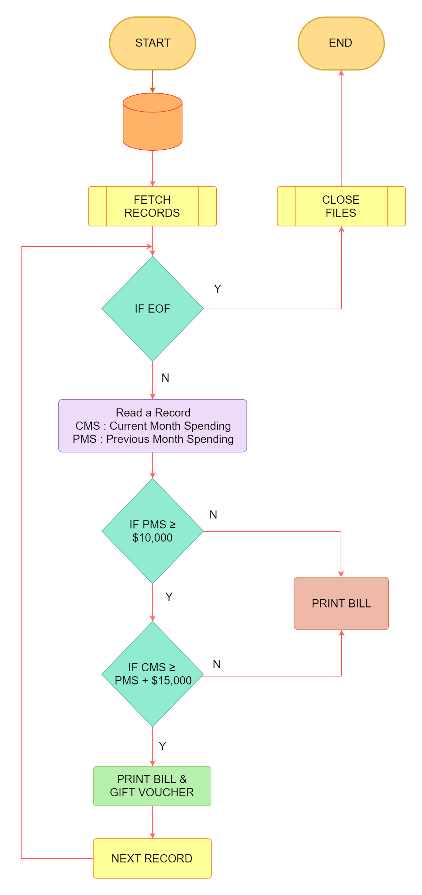
Case Study 7
Flowchart
Draw the flowchart of the promotion

Slide 36
THANKS!
Any questions?
You can find me at:
@volkan
volkan@clarusway.com

